Slide 1
E-commerce Business Models and Concepts

Slide 2
E-commerce Business Models
Business model:
Set of planned activities designed to result in a profit in a marketplace. The business model is at the center of the business plan.
Business plan:
  A business plan is a document that describes a firm’s business model.
E-commerce business model:
  An e-commerce business model aims to use and leverage the unique qualities of the Internet, the Web, and the mobile platform.

Slide 3
Eight Key Elements of a Business Model
Value proposition
Revenue model
Market opportunity
Competitive environment
Competitive advantage
Market strategy
Organizational development
Management team

Slide 4
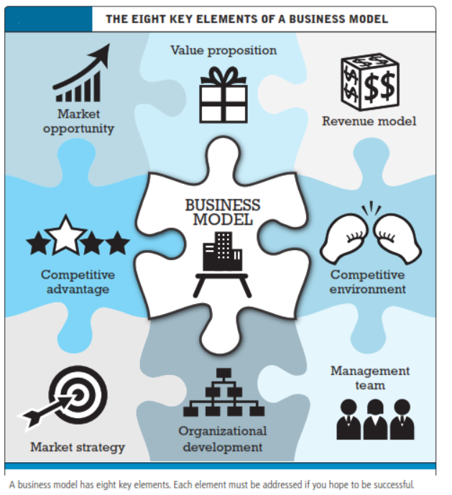
Eight Key Elements of a Business Model

Slide 5
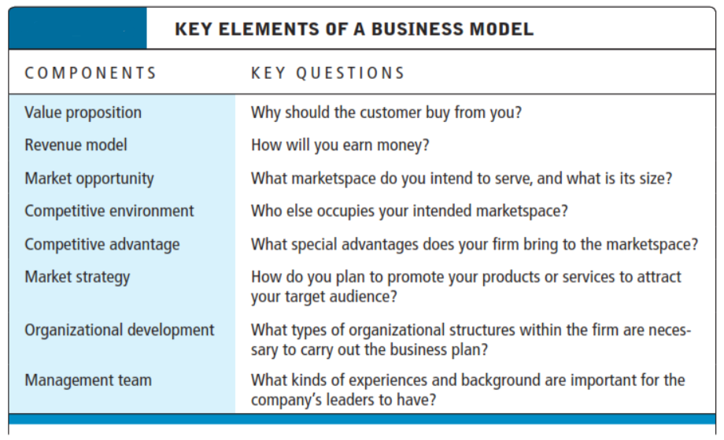
Key Elements of a Business Model

Slide 6
Value Proposition
How does the product or service fulfill customer needs
E-commerce value propositions:
  Personalization/customization
  Convenience
  Price/No shipping cost
  Quick delivery
  Unparalleled Selection
  Product/service quality

Slide 7
Value Proposition
Amazon's Value Propositions Fulfilled:
Personalization/Customization: When Sarah logs in, Amazon shows headphone recommendations based on her previous searches and purchases.
Convenience: She can browse thousands of headphones, read reviews, compare prices, and place an order — all from her phone.
Price/No Shipping Cost: Sarah finds a deal with a discount and sees that her Prime membership offers free shipping.
Quick Delivery: Amazon guarantees next-day delivery, which is perfect since she has a meeting in two days.
Unparalleled Selection: Sarah chooses from multiple brands, colors, and features — all in one place.
Product/Service QualityShe checks verified buyer reviews and ratings to ensure the product meets her expectations.

Slide 8
Revenue Model
How will the company earn money
Major types of revenue models:
  Advertising revenue model- Facebook
  Subscription revenue model –Anti virus, Consumer Reports, Wall Street News Subscription, Online Dating
  Transaction fee revenue model- ebay, E-trade, Credit cards
  Sales revenue model – AmazonMP3, Amazon, Gap
  Affiliate revenue model – airlines/car rentals/hotels

Slide 9
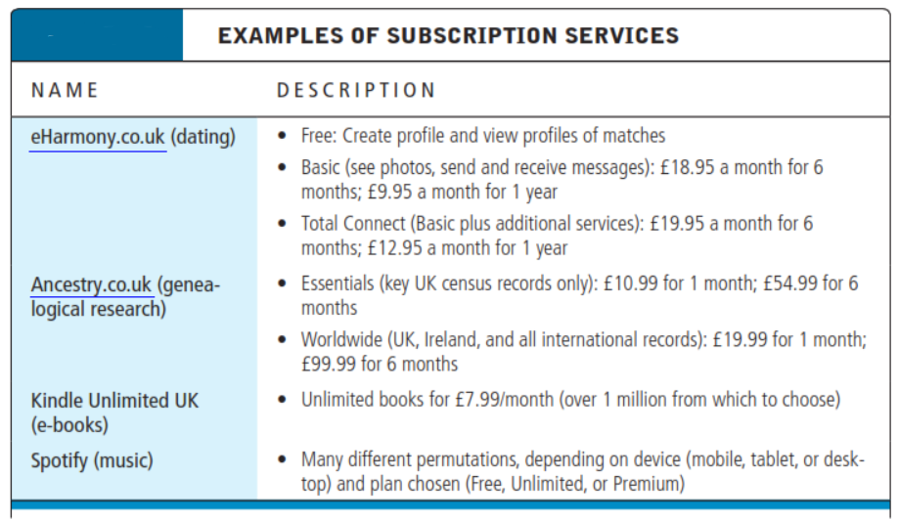
Some Subscription Services

Slide 10
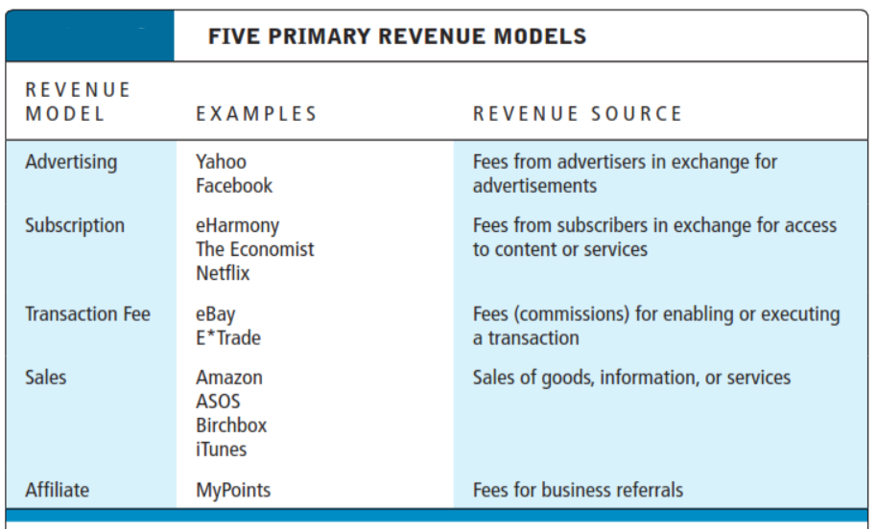
Five Primary Revenue Models

Slide 11
Market Opportunity
The intended Marketspace of the company
  Marketspace: Area of actual or potential commercial value in which company intends to operate
  Realistic market opportunity: Defined by revenue potential in each market niche in which company hopes to compete
Market opportunity typically divided into smaller niches

Slide 12
Competitive Environment
Who else occupies your intended marketspace?”
  Other companies selling similar products in the same marketspace
  New entrants into market, substitute products, and power of consumers and suppliers (nature of competition)
  Includes both direct and indirect competitors.
Influenced by:
  Number and size of active competitors
  Each competitor’s market share
  Competitors’profitability
  Competitors’pricing

Slide 13
Competitive Advantage
Firms achieve a competitive advantage when they can produce a superior product and/or bring the product to market at a lower price than most, or all, of their competitors.
Important concepts:
  Asymmetries exist when one competitor has more resources or differential access to them compared to other competitors
  First-mover advantage
  Unfair competitive advantage results from factors of production that are hard to duplicate or acquire (brands, natural resources, capital investments)
  Leverage using vast resources to move in other markets – leveraging a large customer base, or lots of money (Apple car)
  Perfect markets do not allow for competitive advantage as all firms have equal access to all factors of production

Slide 14
Market Strategy
How do you plan to promote your products or services to attract the target audience
  Details how a company intends to enter market and attract customers
  Best business concepts will fail if not properly marketed to potential customers -IBM OS 2

Slide 15
Organizational Development
The types of organizational structures within
the firm necessary to carry out the business plan
Describes how firm will organize work
  Typically, divided into functional departments, some organize around products, combination of both (auto manufacturers)
  As company grows, hiring moves from generalists to specialists

Slide 16
Management Team
“What kind of backgrounds should the company’leaders have?”
A strong management team:
  Make the business model work
  Give credibility to outside investors
  Has market-specific knowledge
  Has experience in implementing business plans

Slide 17
Raising Capital
Seed capital personal funds used to start business
Traditional sources
  Incubators provide small amount of funding and provide services to start-ups
  Commercial banks
  Angel investors wealthy investors who invest money in exchange for equity share of the business (Shark tank☹)
  Venture capital firms invest funds they manage for other investors
  Strategic partners
Crowdfunding
  Using internet to allow individuals to contribute to new ventures

Slide 18
Crowdfunding Takes Off
What types of projects and companies might be able to most successfully use crowdfunding?
Are there any negative aspects to crowdfunding?
What obstacles are presented in the use of crowdfunding as a method to fund start-ups?

Slide 19
Categorizing E-commerce
Business Models
No one correct way (explained on upcoming slides)
The book categorizes them based on:
  E-commerce sectors (B2B, and B2C)
  E-commerce technology (e.g., m-commerce)
Similar business models appear in more than one sector
Some companies use multiple business models (e.g., eBay, Amazon)

Slide 20
B2C Business Models
E-tailer
Community providers create communities for like minded people (social networks eg. Facebook)
Content provider disseminate info (CNN, ESPN etc)
Portal enable searching to provide info (Yahoo, Google)
Transaction broker (E*TRADE, Hotels.com, Travelocity)
Market creator creates market spaces (Ebay, Amazon)
Service provider (Gmail, Verizon, PayPal, VisaNow.com)

Slide 21
B2C Models: E-tailer
Online version of traditional retailer (Walmart, Macys)
Revenue model: Sales
Variations:
  Virtual merchant (online bank)
  Bricks-and-clicks
  Catalog merchant (home shopping network)
    Sells large variety of household and personal products
  Manufacturer-direct
Low barriers to entry

Slide 22
B2C Models: Community
Provider
Provide online environment (social network) where people with similar interests can transact, share content, and communicate
  Examples: Facebook, LinkedIn, Twitter, Pinterest
Revenue models:
  Typically hybrid, combining advertising, subscriptions, sales, transaction fees, and so on

Slide 23
B2C Models: Content Provider
Digital content on the Web:
  News, music, video, text, artwork
Revenue models:
  Subscription; pay per download (micropayment); advertising; affiliate referral
Variations:
  Syndication- firm does not own material just distributes it (newspaper horoscopes and crossword puzzles are syndicated content)
  Web aggregators (shopping.com, Travelocity, Priceline) aggregate info and add value to it

Slide 24
Battle of the Titans: Music in the Cloud
Have you purchased music online or subscribed to a music service? What was your experience?
What revenue models do cloud music services use?
Do cloud music services provide a clear advantage over download and subscription services?
Of the cloud services from Google, Amazon, and Apple, which would you prefer to use, and why?

Slide 25
B2C Business Models: Portal
Searching capability plus an integrated package of content and services
Revenue models:
  Advertising, referral fees, transaction fees, subscriptions
Variations:
  Horizontal/general includes all internet users
  Vertical/specialized (vortal) provides a directory of links to information related to a particular industry or subject matter
  Searching capabilities

Slide 26
B2C Models: Transaction Broker
Process online transactions for consumers
  Primary value proposition—saving time and money, and enabling online transactions (stocks, credit card and PayPal payments)
Revenue model:
  Transaction fees
Industries using this model:
  Financial services
  Travel services and entertainment
  Job placement services

Slide 27
B2C Models: Market Creator
Create digital environments where buyers and sellers can meet and transact business
Examples:
  Priceline
  eBay
  E*trade
Revenue model:
  Transaction fees, fees to merchants for access

Slide 28
B2C Models: Service Provider
Online services
  Example: Google—Google Maps, Gmail, and so on
Value proposition
  Valuable, convenient, time-saving, low-cost alternatives to traditional service providers
Revenue models:
  Sales of services, subscription fees, advertising, sale of marketing data

Slide 29
B2B Business Models
B2B relies on EDI (electronic data interchange)
Net marketplaces (explained in upcoming slides)
  E-distributor
  E-procurement
  Exchange
  Industry consortium
Private industrial network

Slide 30
B2B Models: E-distributor
Version of retail and wholesale store, MRO (explain next slide) goods, and indirect goods
Owned by one company seeking to serve many customers
Revenue model: Sales of goods
Example: Grainger.com

Slide 31
MRO
MRO - Maintenance, repair and operations
Supplies consumed in the production process but which do not either become part of the end product or are not central to the firm's output. MRO items include consumables (such as cleaning, laboratory, or office supplies), industrial equipment (such as compressors, pumps, valves) and plant upkeep supplies (such as gaskets, lubricants, repair tools), and computers, fixtures, furniture, etc.

Slide 32
B2B Models: E-procurement
Creates and sells access to digital markets where participants transact for indirect goods
  B2B service providers, application service providers (ASPs)
Revenue model:
  Service fees, supply-chain management, fulfillment services
Example: Ariba- system provides sellers with the ability to manage catalogs, bids, purchases and invoices and provides buyers with the ability to search for suppliers, negotiate savings, procure goods and services and track spending.
http://www.ariba.com/about/our-story

Slide 33
B2B Models: Exchanges
Independently owned vertical digital marketplace where hundreds of suppliers meet a small number of large commercial purchasers
Revenue model: Transaction, commission fees
Create powerful competition between suppliers
Tend to force suppliers into powerful price competition; number of exchanges has dropped dramatically
Example, Walmart has the ability to negotiate the best prices in the industry

Slide 34
B2B Models: Industry Consortia
Industry-owned vertical digital marketplace open to select suppliers
More successful than exchanges
  Sponsored by powerful industry players
  Strengthen traditional purchasing behavior
Revenue model: Transaction, commission fees
Example: Exostar used by defense industry - http://www.exostar.com/Mission/
ICAMR: International Consortium for Advanced Manufacturing Research

Slide 35
Private Industrial Networks
Digital network used to coordinate among firms engaged in business together
Represents 75% of B2B business by large firms
Often owned by a large network firm
Example: Walmart’s network for suppliers
Cost absorbed by network owner and recovered through production and distribution efficiencies

Slide 36
Difference between Exchange, Consortia, Private Industrial Network
Exchange | Consortia | Private Industrial Network
Hundreds of suppliers meet small number of large buyers Generate revenue by a commission or fee based on the size of the transaction Usually serve a single industry | Is industry owned Serves a vertical marketplace | Coordinate the flow of communications among firms doing business together Participation is by invitation only Walmart operates the largest private network

Slide 37
How E-commerce Changes Business
E-commerce changes industry structure by changing:
  Rivalry among existing competitors
  Barriers to entry
  Threat of new substitute products
  Strength of suppliers
  Bargaining power of buyers

Slide 38
Industry Value Chains
Set of activities performed by suppliers, manufacturers, transporters, distributors, and retailers that transform raw inputs into final products and services
Internet reduces cost of information and other transactional costs
Leads to greater operational efficiencies, lowering cost, prices, adding value for customers

Slide 39
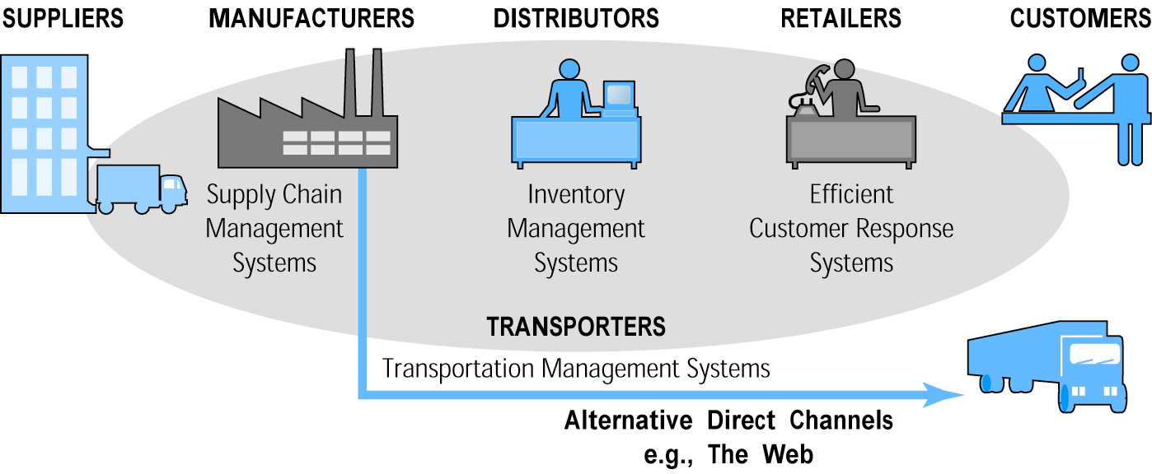
E-commerce and Industry
Value Chains

Slide 40
Firm Value Chains
Activities that a firm engages in to create final products from raw inputs
Each step adds value
Effect of Internet:
  Increases operational efficiency
  Enables product differentiation
  Enables precise coordination of steps in chain

Slide 41
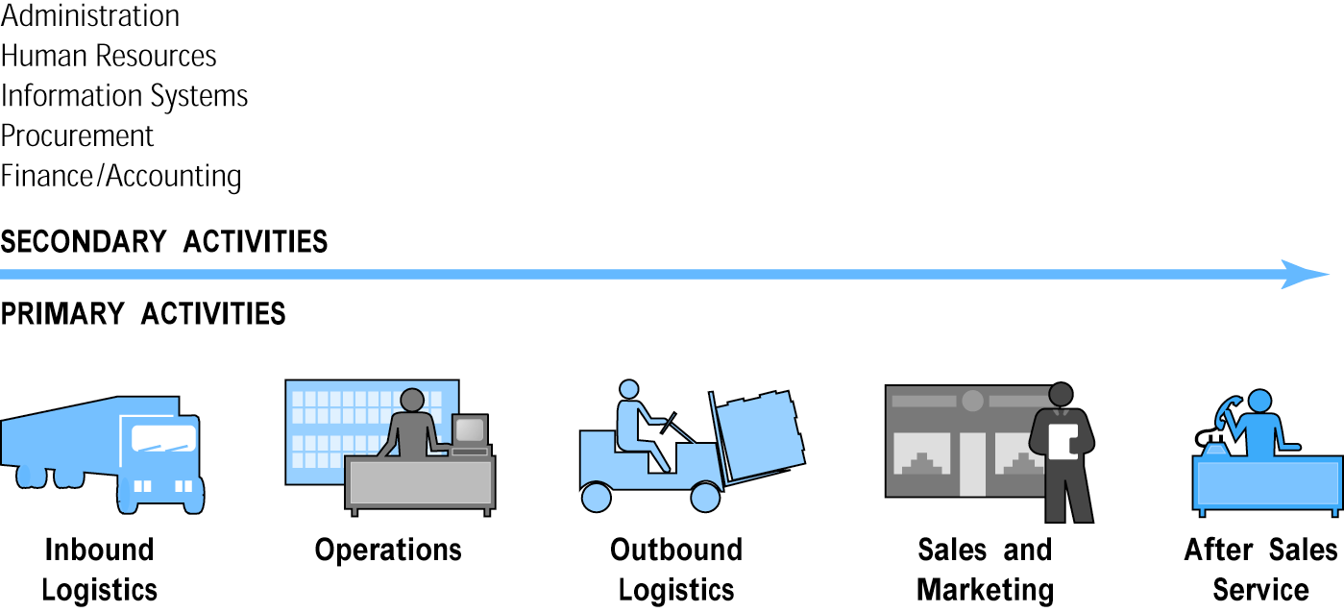
E-commerce and Firm
Value Chains

Slide 42
Firm Value Webs
Networked business ecosystem
Uses Internet technology to coordinate the value chains of business partners
Coordinates a firm’s suppliers with its own production needs using an Internet-based supply chain management system

Slide 43
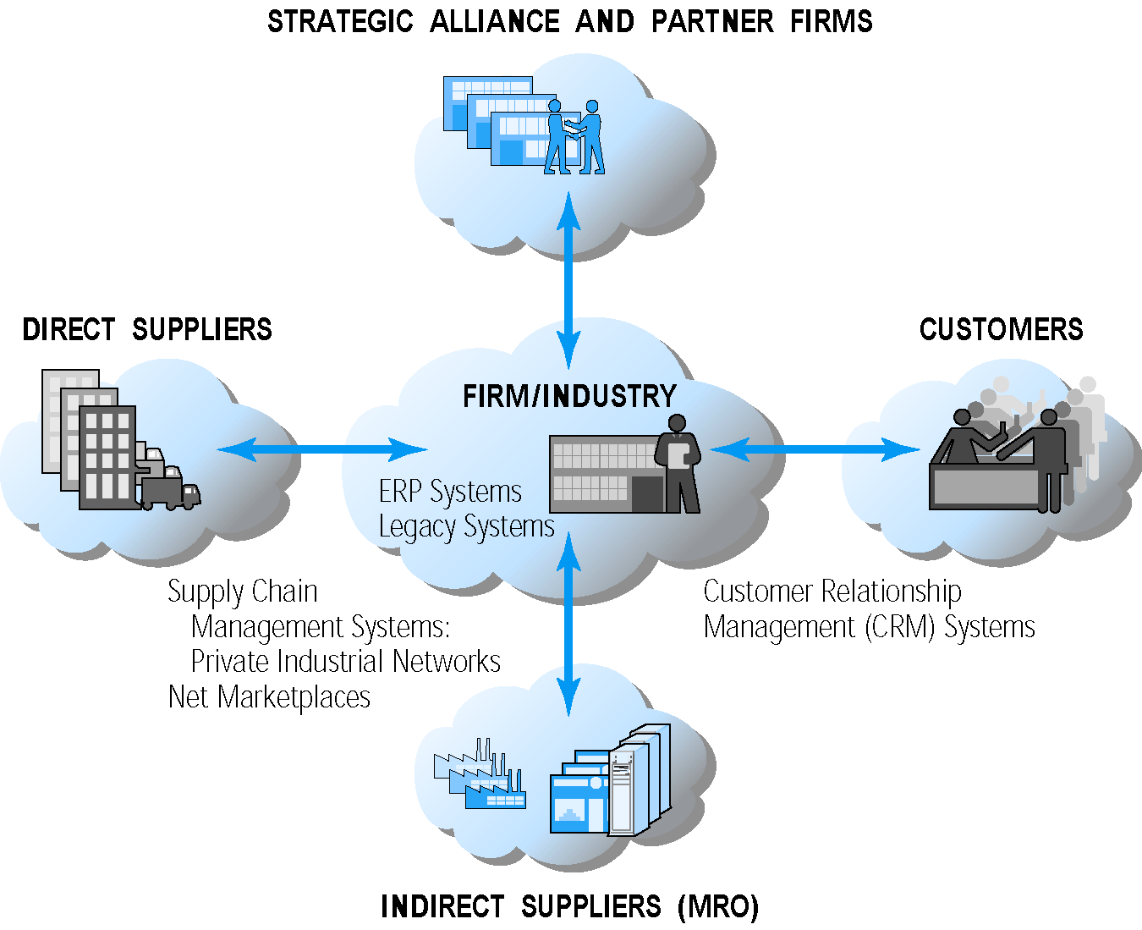
Internet-enabled Value Web

Slide 44
Business Strategy
Plan for achieving superior long-term returns on capital invested: that is, profit
Five generic strategies
  Product/service differentiation
  Cost competition
  Scope
  Focus
  Customer intimacy: A marketing strategy where a service supplier or product retailer gets close to customers. The benefits include improved highly tailored problem solving capabilities, greater customization of products to customer needs, as well as higher customer loyalty.

